Slide 1


Real-time facial recognition system using webcam EEE 4702_Digital Signal Processing Lab Group Project
Md. Abu Sayeed Zamee Chowdhury 160021123
Md Mohi Uddin Khan 160021163
Section-c1_Group-11
DEPARTMENT OF ELECCTRICAL & ELECTRONIC ENGINEERING

Slide 2
Objective
Create a face detector using OpenCV and webcams
Create a face recognizer using OpenCV and face_recognition library
Create a face recognition system using realtime webcam feed
Ensuring accurate results of images fed into the system
Save recognized face names with Date & Time as *.txt file.

Slide 3
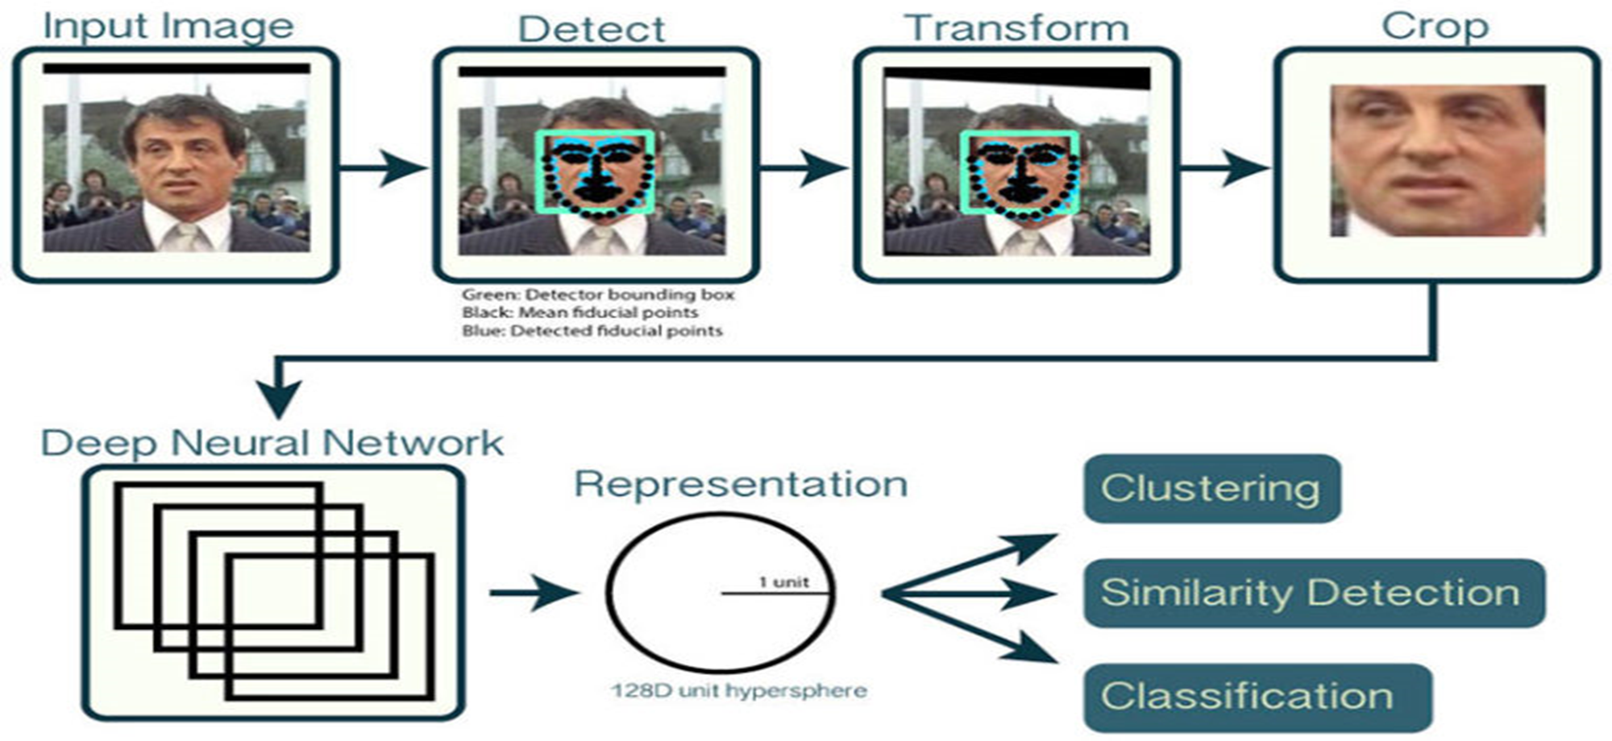
Methodology

Slide 4
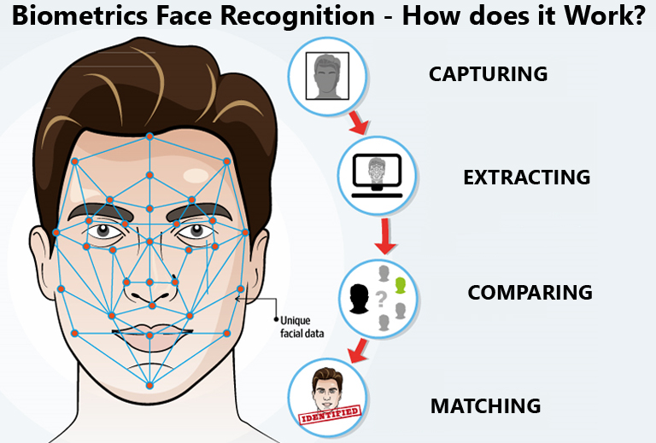
Capturing
Takes images from the known_faces directory on our local computer
The images can be labelled in any way. For our convenience, we chose to name them according to the person.
The images should have well defined and illuminated face and contain only one face that is to be capture
The webcam captures faces on the frame when it turned on using OpenCV. These faces are detected and captured using the face_recognition library. These are saved in the cache memory.

Slide 5
Extracting
The images from the faces directory are encoded and facial features extracted using the built in library.
The landmarks are saved in variables we named for each individual image.
The webcam uses OpenCV to extract features and landmarks from the face it has detected in the frame
These are saved in the Training_dataset.csv

Slide 6
Comparing
The encodings and landmarks extracted from the images in our face directory are converted to Euclidean distances using built in functions such as np.argmin
The encodings and landmarks extracted from the faces detected on the webcam are converted to Euclidean distances using built in functions such as np.argmin
These two are compared and the difference is found

Slide 7
Matching
The Euclidean distance of the face detected on the webcam frame is compared with the Euclidean distance of the faces we have in our local directory.
The images with which we have the smallest distance is the corresponding image on the webcam.
Then using OpenCV we draw a rectangle around the detected face on the webcam frame and label who the algorithm thinks it is.

Slide 8
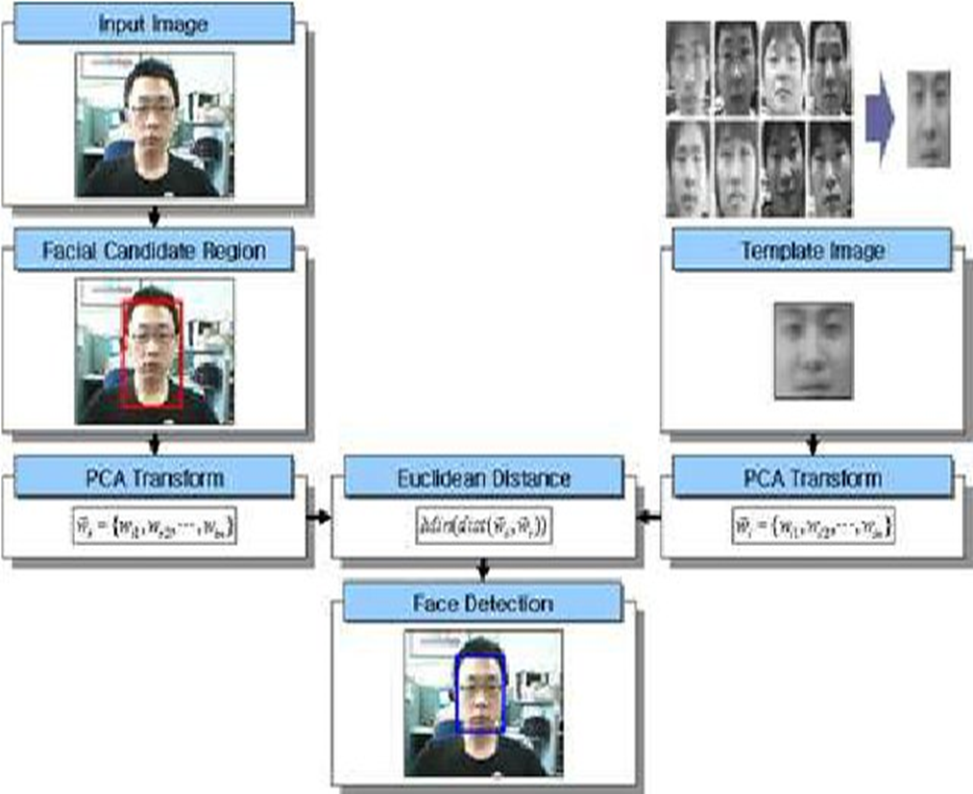
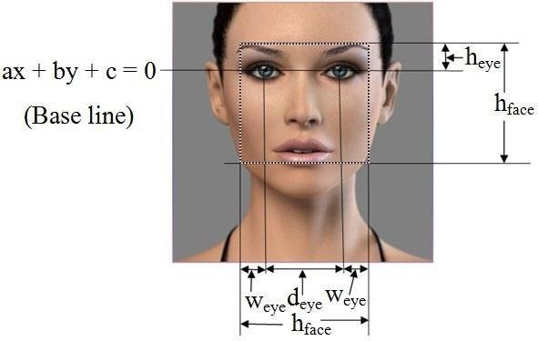
The face_recognition algorithm in a nutshell
An example of the distances measured from faces

Slide 9
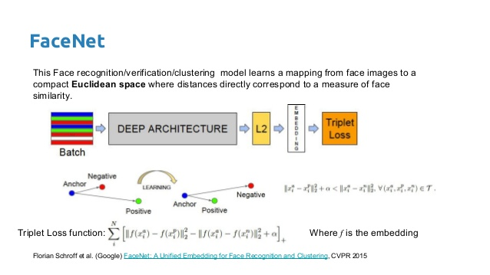
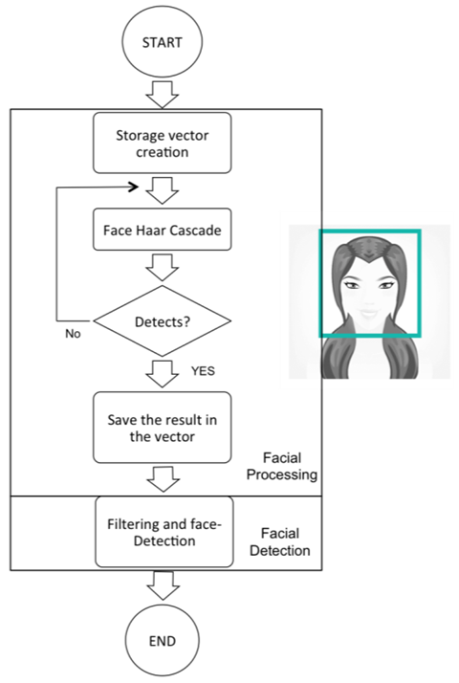
Neural Network structure of algorithm
Flowchart of the algorithm

Slide 10
Strengths and Opportunities
Easy to use and code
Ability to scale up
Requires only one well detailed image of the person
Relatively small runtime
Works with relatively low resolution webcams
Uses built-in libraries with pretrained weights

Slide 11
Weaknesses:
Can not differentiate between 2D and 3D
Requires extensive libraries and dedicated CUDA enabled GPU
Works with frontal faces
Needs proper illumination
Small dataset
Can handle images of maximum 3000 by 3000 pixels

Slide 12
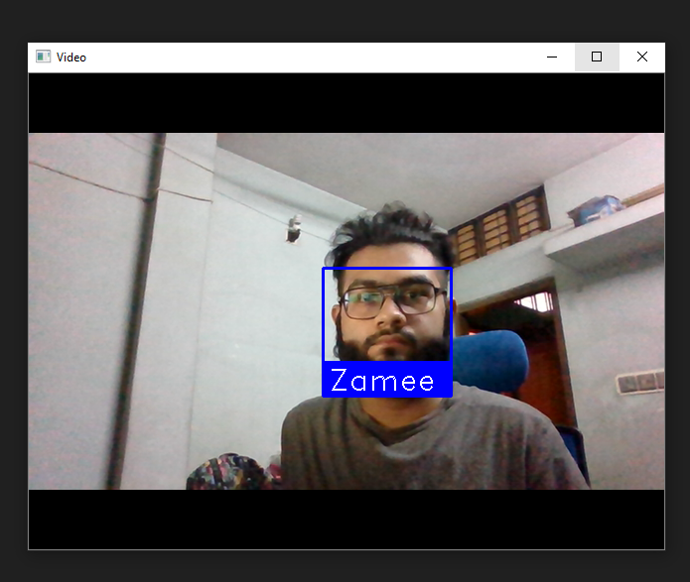
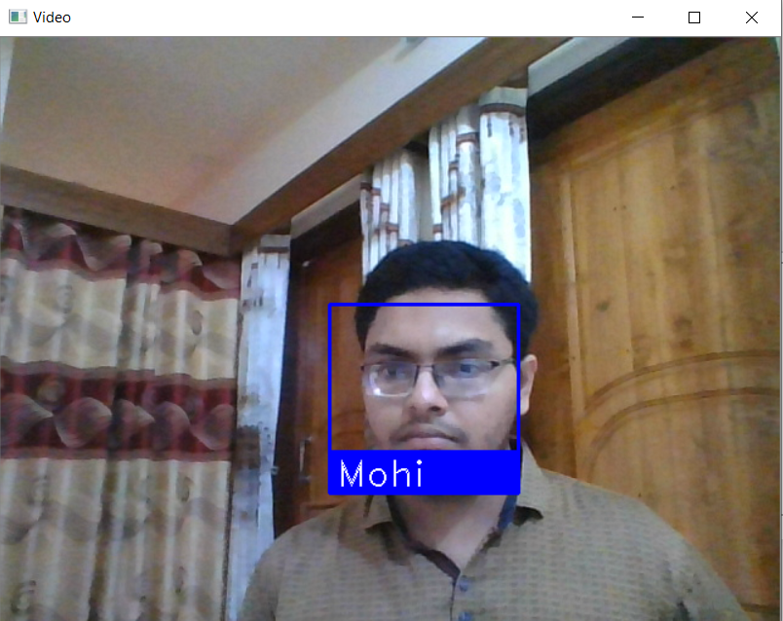
Results as Snapshots

Slide 13
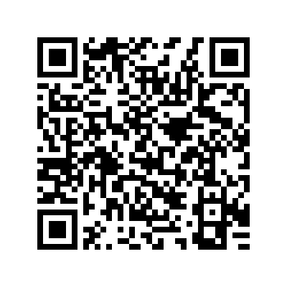
Results in Video format
Scan or Click on the QR code

Slide 14
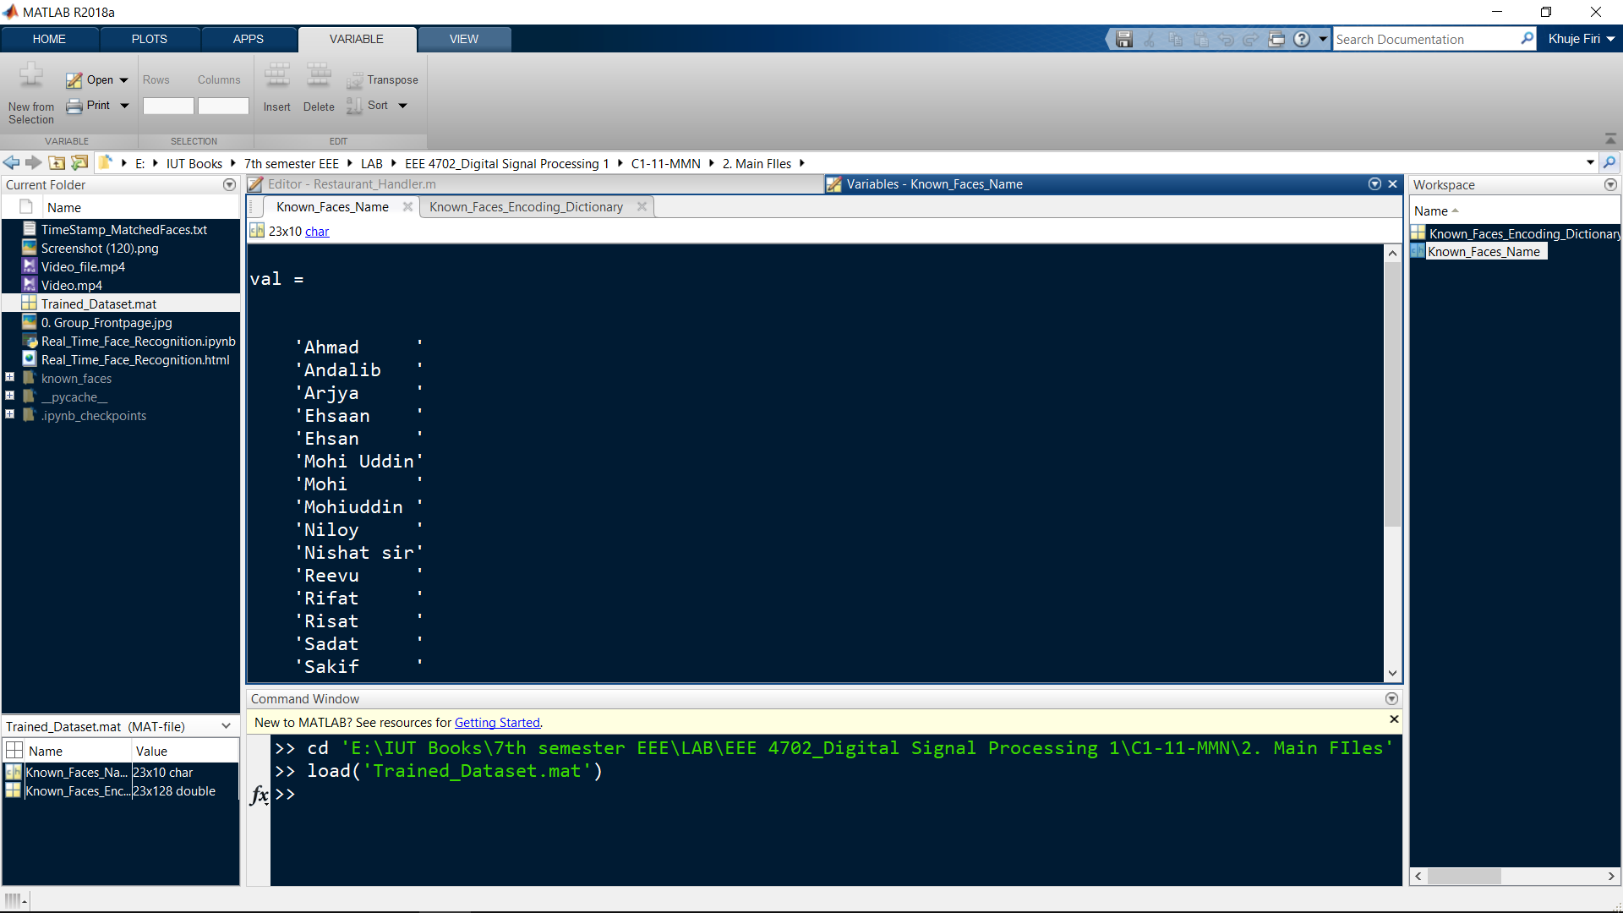
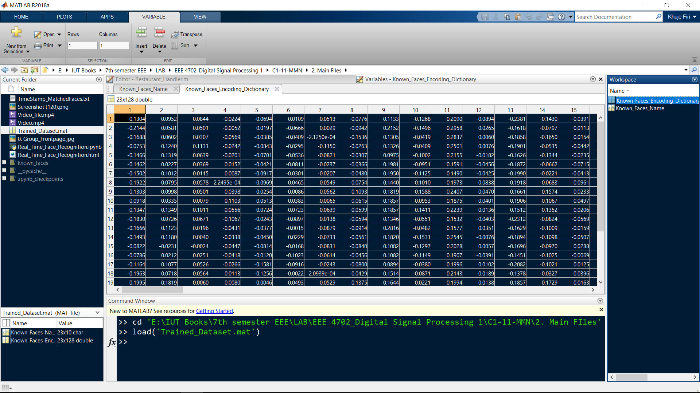
Saved Trained Model variables as *.mat file

Slide 15
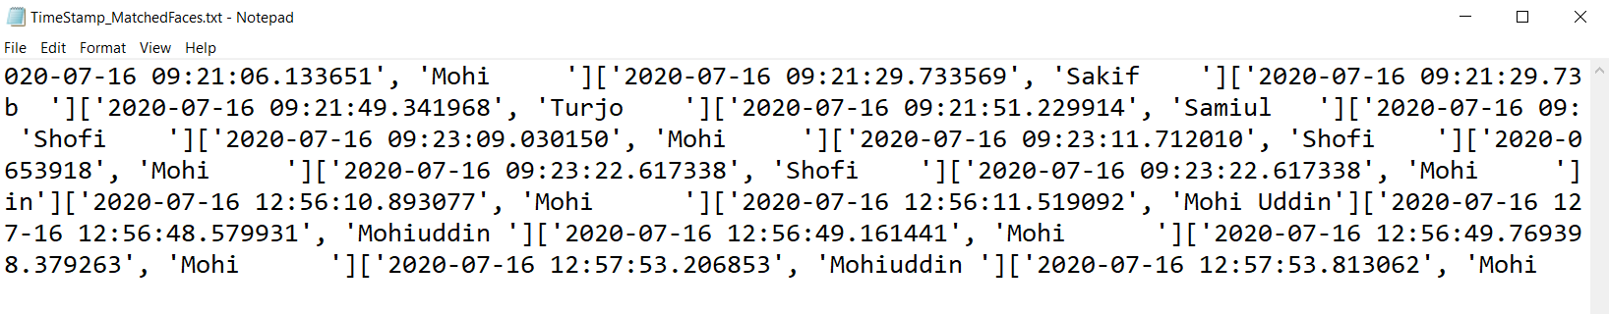
Matched faces with Date & Time saved as *.txt file:

Slide 16
Conclusion
This project has the ability to be scaled for usage as an Attendance Management System using only one image of the people involved
The Trained_Dataset can be used to train and run the program on separate devices

